Slide 1
ME 781 Group Project
Final Report
Group 35
B C Gunawanth Rayalu 210040031
Kritika Arya 20d170021
Mohd Danish Siddiqui 22b2104
Rijvan khan Rafiq khan 23M1587
Satwik Murarka 190020101
Vishal Kumar Singh 22m0001

Slide 2

AI Powered Customer Relationship Management System
Objective
We are planning to create a CRM system that analyzes customer interactions and data using AI techniques to generate personalized suggestions that aid sales and the consumer experience. We would implement two models to provide insights:
Customer Churn Prediction - This model uses customer data to predict whether a customer would continue the services or leave.
Customer Sentiment Analysis - This model analyzes the sentiment of a piece of text to gauge the satisfaction levels of the customer

Slide 3
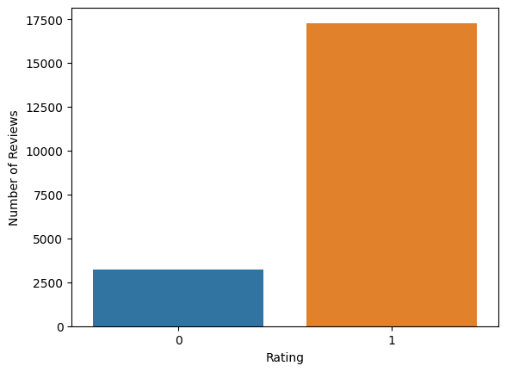
Model 1: Customer Sentiment Analysis
The model takes text from the user and classifies it into positive or negative according to the sentiment of the text.
The text is first pre-processed by removing stopwords, punctuations, stemming, lemmatization and then tokenization. TFIDF vectorization is used to map the words to numbers
The model used for this task is Logistic Regression as it showed the highest F1 score when performing StratifiedKFold Cross Validation as compared to Decision Trees and Random Forests.
As the dataset was unbalanced we used F1 score metric and StratifiedKFold Cross Validation to ensure all classes had similar representation in the model.
Further Hyperparameter Optimization was done using Random Search to find the optimum parameters of the Logistic Regression model.

Slide 4
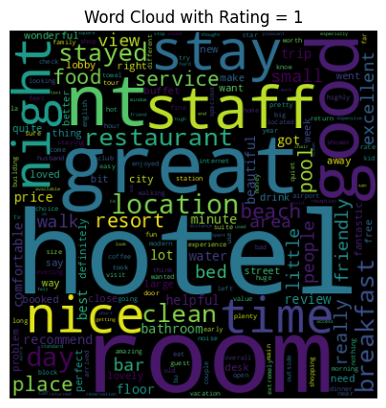
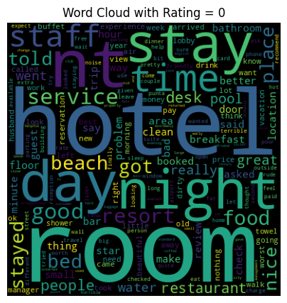

Slide 5
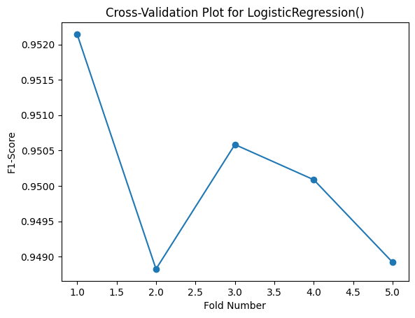
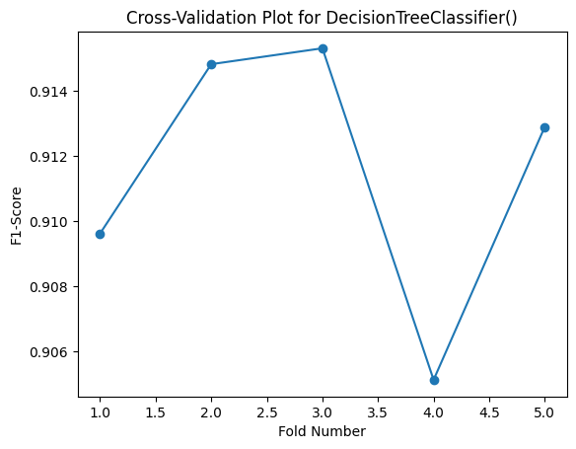
Model Training: Cross Validation Scores for Various Folds:
Mean Cross-Validation F1 Score for Decision Tree: 0.91
Mean Cross-Validation F1 Score for Logistic Regression : 0.95

Slide 6
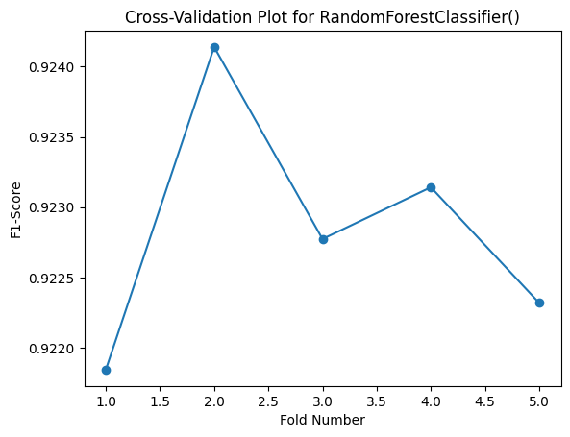
Mean Cross-Validation F1 Score for Random Forest Classifier: 0.92

Slide 7
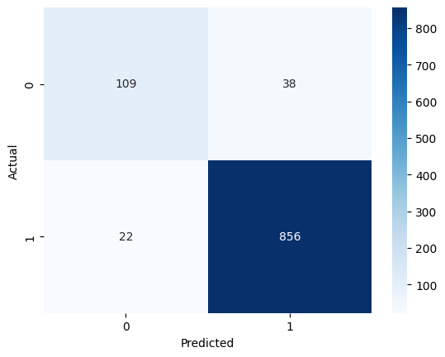
Model Test Results for Logistic Regression:
The logistic regression model after hyperparameter optimization obtained an F1-Score of 0.94 on the test set. The confusion matrix is attached below:
Confusion Matrix on Test Set

Slide 8
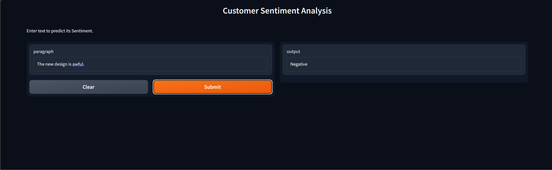
User Interface and Output/Guide:
The user interface was built on Gradio and user enters a piece of text in the input box to know whether the text is negative or positive:
Example of Negative Sentiment

Slide 9
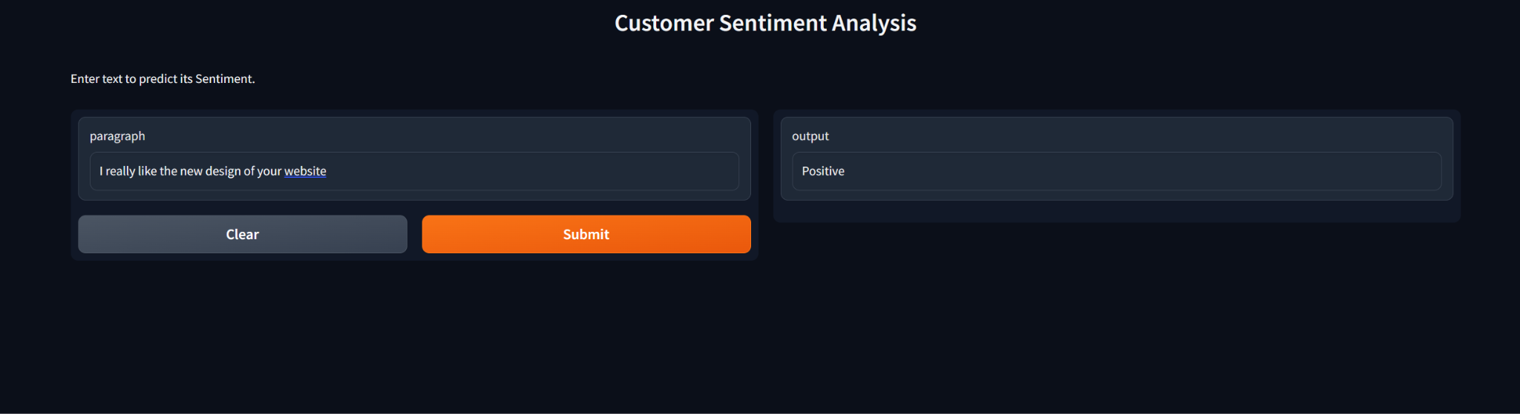
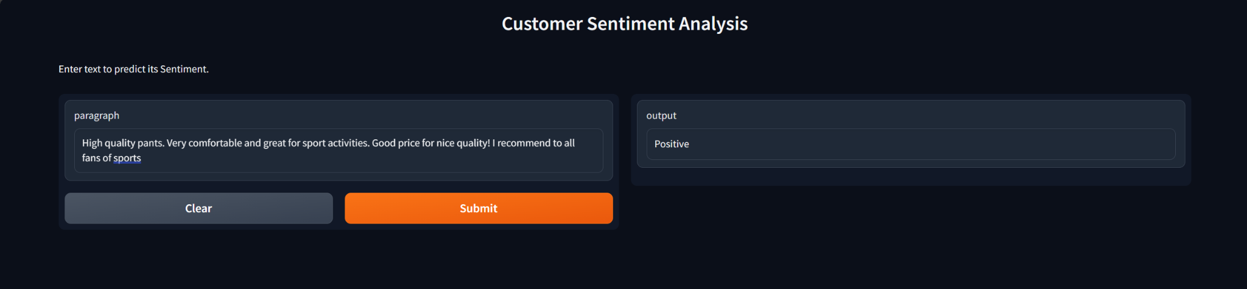
Examples of Positive Sentiment

Slide 10
Working Code for Model 1:
The following Colab contains the pre-processing, cross validation and hyperparameter tuning for the customer sentiment model. It uses the reviews dataset which is uploaded on GitHub. Change the address appropriately of the file before running.
https://colab.research.google.com/drive/1wVEBhvtpcXpocX4Lk2U8MDOgrcFrZEPo?usp=sharing
The below file contains the code for the gradio interface. It uses two pickles files which are also uploaded at the Github link.
https://colab.research.google.com/drive/1ZPdO422XUziPkL9lndJZ-wF391dannhC?usp=sharing

Slide 11
Model 2: Customer Churn Prediction
In this model, we are taking input from the user and classifies into positive or negative according to the given input
Here we are using the model ensemble technique for the data classification
We are using three models namely Logistic , RandomForest and XGBoost Classifiers for this purpose
The idea involves hyperparameter tuning for each model separately and getting their best parameters or best models to be precise
Finally using the best hyperparameters or models and combining them with the help of Voting Classifier and thus combining the powers of multiple models to achieve good accuracy

Slide 12
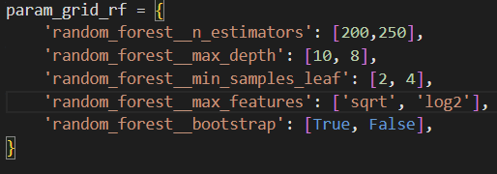
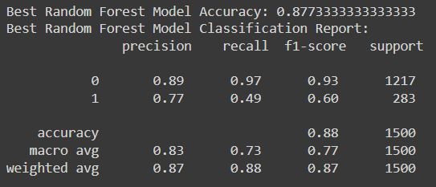
Best Hyperparameters for Random Forest Classifier
The parameters search space is as follows
The metrics for this model is
Best Hyperparameters for Random Forest: {'random_forest__bootstrap': True, 'random_forest__max_depth': 10, 'random_forest__max_features': 'log2', 'random_forest__min_samples_leaf': 4, 'random_forest__n_estimators': 250}

Slide 13
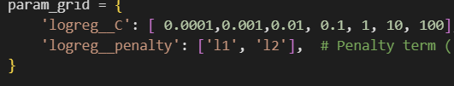
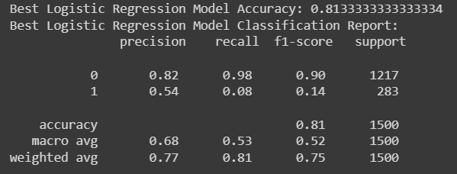
Best Hyperparameters for Logistic Classifier
The parameter search space is as follows:
Metrics for this model is as follows:
Best Hyperparameters for Logistic Regression: {'logreg__C': 0.0001, 'logreg__penalty': 'l2'}

Slide 14
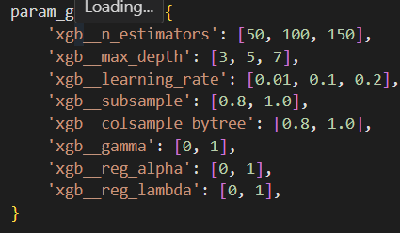
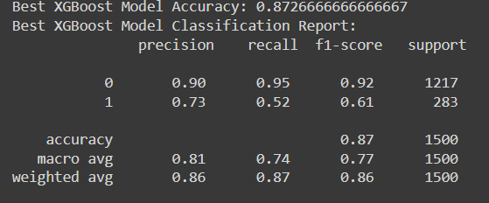
Best Hyperparameters For XGBoost Classifier
The parameter search space is as follows:
The metrics for this model :
Best Hyperparameters for XGBoost: {'xgb__colsample_bytree': 0.8, 'xgb__gamma': 1, 'xgb__learning_rate': 0.2, 'xgb__max_depth': 3, 'xgb__n_estimators': 50, 'xgb__reg_alpha': 0, 'xgb__reg_lambda': 0, 'xgb__subsample': 0.8}

Slide 15
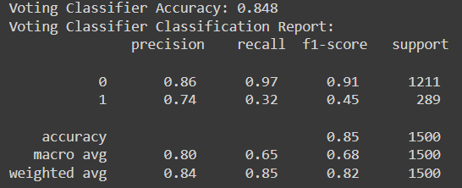
Final Model : Voting Ensemble
On combining the result is as follows :

Slide 16
Working Code for Model 2:
The working code for this model is given below in google collab link .It contains all preprocessing ,exploratory data analysis ,statistical analysis , pipeline construction and all the metrics for these models.
https://colab.research.google.com/drive/1aIcoevIjpwPuLGZVg55Xt3nYivUQ46ch#scrollTo=WVXgTt1KHDn4

